Slide 1
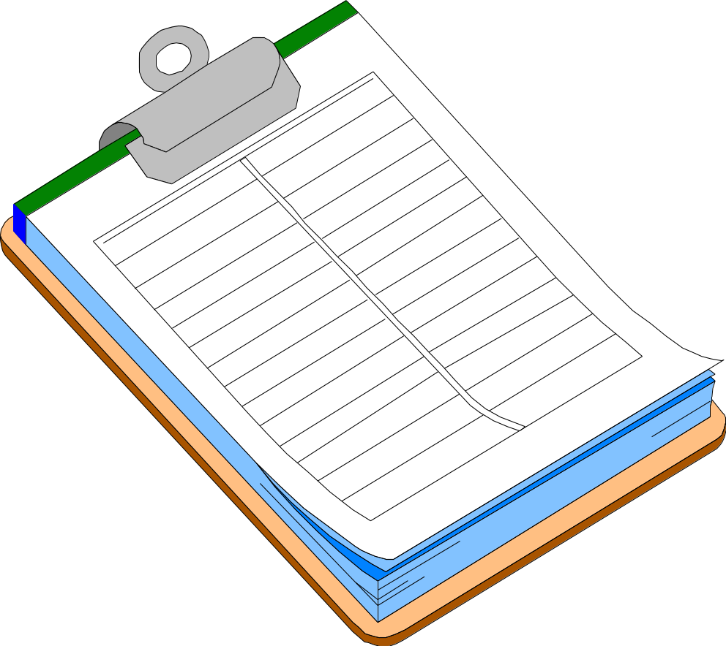
Safe Work Permit System

Slide 2
What is Work Permit System ?
.... The Work Permit System is a formal
Safety System, the objective of which is to control specific work activities which are known to be potentially hazardous.

Slide 3
“ A Work Permit is not a permission to carry out hazardous jobs. It is an essential part of a system which determines how that job can be carried out safely and clearly identifies the controls to be put in place.”

Slide 4
Safe Work Permits
Cutting / Welding
Permit
Location: Job No.
Date: Job No.
Location & Building: Floor
Nature of Job:
Welder’s Name:
The above location has been examined. The precautions checked
on the reverse of this card have been taken to prevent fire.
Permission is granted for this work.
Permit Date: Time:
Expires AM
PM
The Hot Work Permit is a form
of Safe Work Permit issued by
the Fire Marshal or other person
responsible for fire safety.
This permit is required for all
situations which may result in
fires or explosions.

Slide 5
Safe Work Permits
Confined Space Entry Permit
Location and description of confined space:
Reason for entry:
Permit issued to:
Supervisor’s Name:
Attendant’s name:
Permit issuer’s name:
% oxygen: % lower explosive limit: ppm CO: H₂S:
Requirements
Emergency Rescuer yes no
Continuous Gas Monitor yes no
Barrier for ground openings yes no
Warning Signs yes no
Safety Harness with life line yes no
Tripod / Hoist / Pulley yes no
CAUTION
Opening in Ground
Keep Out !
The “Confined Space Entry
Permit” is another form of
safe work permit regulating
entry into pits, tanks, and vessels.

Slide 6
Safe Work Permits
Safe Work Permit Permit #
Type: (hot work, confined space, line break, etc.... location:
Valid __/___/___ ____ __/___/___ ____ Issued to:
From: M D Y time to M D Y time
Work Description: ________________________________
____________________________________________ Supervisor’s Signature Print name
____________________________________________
____________________________________________ Work Order No.
Atm Combustible vapors or gases (<10%) Oxygen Concentration (>19.5% & <21%) Toxic Material Concentration
Tests
Precautions Always Required:
The objective of the Safe Work Permit system is to
identify hazards associated with a job, and to develop precautions required to control each hazard identified.

Slide 7

Safe Work Permits
Let’s begin with a
look at the hazards
associated with
specific jobs, and
examine how Safe
Work Permits can
help to prevent
them from causing
damage or injury.

Slide 8
Safe Work Permits
Examples of jobs requiring permits are:
1. Hot Work - the use of open flame, oxyacetylene burning,
tar kettles, etc...., and the use of portable spark or heat producing
equipment in flammable storage or handling areas.
2. Confined Space Entry
3. Excavations
4. Blasting
5. Whenever required by existing company or contractor procedures
or required in the contractor’s Project Safety Plan.
6. Use of internal combustion engines, or vehicles
with internal combustion engines inside company buildings.
7. Use of company owned equipment, such as personnel lifts,
fork trucks, vehicles, etc., by employees of a contractor

Slide 9

Safe Work Permits
Excavations :
Poorly planned excavations can result in
damage to underground services, such as
electrical lines, natural gas lines, water
lines, sewers and drains.
The consequence of damaged service lines
is often complete shutdown of operations
resulting in major business losses.
Permits are written to prevent damage to
underground equipment and services.

Slide 10

Safe Work Permits
Blasting can cause damage
to adjacent operations and
personnel.
Permits are issued to ensure
procedures are followed that
prevent injury to neighboring
facilities, equipment and
employees.

Slide 11
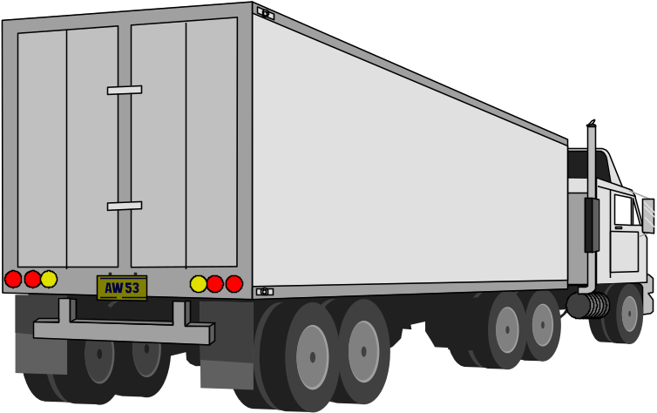

Safe Work Permits
Internal combustion engines produce poisonous gases
such as carbon monoxide, and oxides of nitrogen.
Permits ensure that procedures are followed that will prevent
equipment emissions from contaminating air inside buildings
and confined spaces.

Slide 12
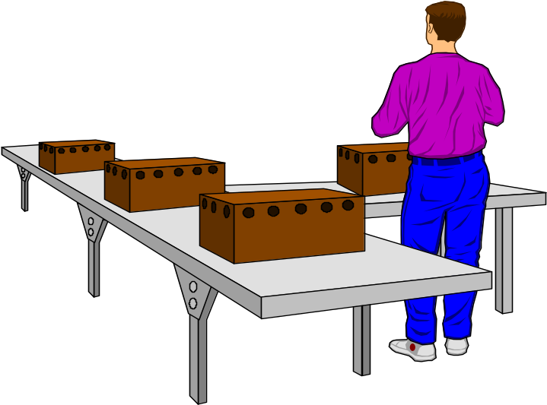

Safe Work Permits
Unauthorized use of company
equipment can result in lost
production and injury to untrained
operators.
Permits prevent company equipment
from being taken by contractors
without the permission of area
management, and require
verification of equipment operator
training.

Slide 13
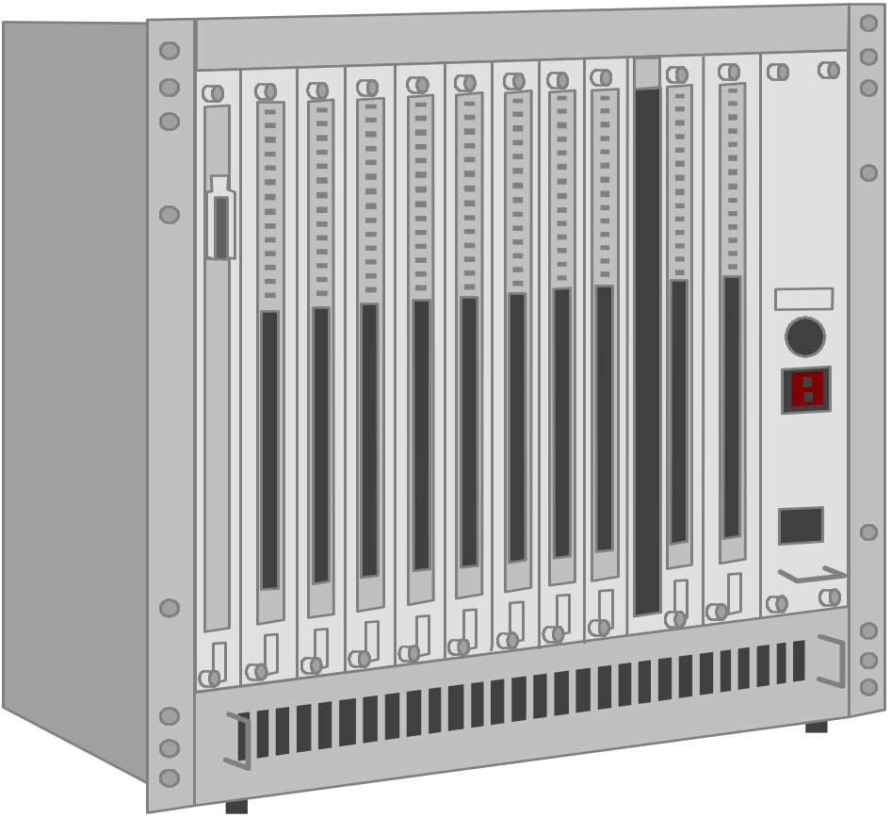
Safe Work Permits
Movement of
large pieces of equipment,
especially while other personnel
are working nearby, can result
in employee injury.
Permits may be issued to ensure
the use of procedures that will
prevent employee injury from
falling material, or being struck
by rigging equipment.

Slide 14


Safe Work Permits
Abandoned tanks, pipe lines,
drums, and vessels may contain
hazardous vapors and gases.
Permits may be issued to prevent
toxic or corrosive exposures to workers
when working on abandoned
equipment, complementing hot work
and confined space permits.
?

Slide 15


Safe Work Permits
Many industrial processes
create noise levels high enough
to cause hearing loss.
Permit requirements may be issued
to reduce noise to acceptable limits,
or to provide both construction and
other employees with required
hearing protection.

Slide 16

Safe Work Permits
Permits may be required
where the consequence
of noncompliance with
fall protection requirements
is severe, or where dropped
materials may endanger
other workers below.

Slide 17

Safe Work Permits
Permits are required
before work begins near
energized lines which cannot
be shut off if there is danger
of fire, shock or electrocution.

Slide 18
Safe Work Permits
CAUTION
Hazardous Materials!
“Safe Work Permit Required!”
Permits are mandatory where signs are
posted which require them.

Slide 19
Safe Work Permits
Safe Work Permit Permit #
Type: (hot work, confined space, line break, etc.... location:
Valid __/___/___ ____ __/___/___ ____ Issued to:
From: M D Y time to M D Y time
Work Description: ________________________________
____________________________________________ Supervisor’s Signature Print name
____________________________________________
____________________________________________ Work Order No.
Permits are issued:
- for a specific date and time range,
- for a specific job,
- and to specific individuals.

Slide 20
Safe Work Permits
Safe Work Permit Permit #
-------------------------------------------------------------------------------------------------------------------------------------------------------------------
Work Description: ________________________________
____________________________________________ Supervisor’s Signature Print name
____________________________________________
____________________________________________ Work Order No.
Atm. Combustible Vapors or gases (<10%) Oxygen Concentration ( >19.5% & < 21%) Toxic Material Concentration
Tests
Permit Issued by: _________________________/____/___ Work Area Manager Approval _______________/___/__
Permits must be reviewed and signed by:
- the safety representative issuing the permit,
- the workers’ supervisor,
- affected workers,
- and the work area manager.

Slide 21
Safe Work Permits
Safe Work Permit
----------------------------------------------------------------------
Precautions Always required:
o Emergency procedures review by:
o Emergency equipment & location review by:
o Area inherent hazards review by:
o Material Safety Data Sheet(s) review by:
Workers must be informed of required emergency procedures, location
and operation of emergency equipment,and area inherent hazards.
Material Safety Data Sheets must be supplied and special
precautions reviewed with workers and their supervision.

Slide 22
Safe Work Permits
Safe Work Permit
----------------------------------------------------------------------
Special Precautions Required:
o Buddy System o Sprinklers in Service
o Cleaning of _________ o Purging of ________
o Remove materials from ___________________
o Piping o Drain o Disconnect o Blank off / Capped
o Clean o Ventilate
o Remove combustibles from other side of wall.
o Floor Swept Clean of Combustibles
o Clean area within 35 feet. o Wet down floor.
o Adjacent areas: __________________________
o Cover floor with: __________________________
o Non-combustible Tarpaulins or Metal Shields Over:
o Electrical Switches or Valves off, locked-out, and Tagged:
o Electrical Grounding of: ________________________
o Atmosphere monitored during work for: ____________
periodically: __________ continuously: __________
o Safety Monitor(s) present from _________ to _________
o Fire Watch Present during work and for 30 minutes after...
o Respirator to be worn____ or be readily available ___
Required special precautions
must be clearly indicated and
communicated to workers,
and their supervision.
It is the safety representative’s
responsibility to determine if
and when special measures
are required.

Slide 23
Safe Work Permits
Safe Work Permit
----------------------------------------------------------------------
Safety Equipment Required
o safety glasses
o hard hat
o face shield
o safety shoes
o fire extinguishers - type ___ #___ size ___
o fire hose
o supplementary illumination
o warning signs
o barricades
o non-sparking tools
o explosion proof equipment
o safety harness
o life line
o tripod emergency escape unit
o 2-way radio or phone
o respirators
o impervious gloves
o protective clothing _____________________
o mechanical ventilation
o shower & eyewash
o self contained breathing apparatus
o ground fault circuit interrupter
o ladder / lift / scaffold
o other________________________________
Personal protective equipment
and other safety equipment required
is specified.
For each hazard present at the work
site, the safety representative must
specify a hazard control.

Slide 24
Safe Work Permits
The safety representative must verify
that all underground utilities have
been located and staked out.
Provisions must be made to
barricade the open trench, prevent
collapse of trench walls, provide
employees with a means of exit,
reroute ground water, and all other
requirements of excavating.
If soil is contaminated, the safety
representative will ask for a written
safety and health plan.
Safe Work Permit
----------------------------------------------------------------------
EXCAVATION PRECAUTIONS REQUIRED:
o Underground / Underfloor Utility Hazard Review
o Soil Excavation Reviewed
o Underground Utility Stakeout Performed
o Excavation cut back 1/1, or walls reinforced
o Means of exiting within 25 feet.

Slide 25
Safe Work Permits - SUMMARY
- Hot work, confined space entry, excavations, blasting,
use of internal combustion engines inside of buildings,
use of company owned or leased equipment, and areas where
“Safe Work Permit Required” signs are posted always require
a safe work permit.
- Other safe work permits may be required at the discretion
of the Safety Representative, the Contract Administrator,
or the Contractor.
- Permits will be issued by a qualified safety representative.
- Hot work permits are issued by the Fire Marshal.
- Permits are issued to specific persons for a specific time
period and for a specific job.
- Permits must be signed at the time issued by the safety
representative, job supervisor, affected workers, and
the manager of the area in which work is being done.

Slide 26
REMEMBER!!!!!
System such as Work Permit are only a burden BEFORE a serious incident ...... they are not a burden AFTER the incident, when the record shows clearly that YOUR responsibilities had been efficiently executed.
( Work Permit is A Legal Document )

